Slide 1
Hospital cost for healthcare industry restricted to the city of Wisconsin:- The patients are in the age group of 0 to 17 years. survey of hospital cost was conducted by us agency for healthcare. Submitted by: Ravi Chaubey trainer name: Deepti gupta
INTRODUCTION

Slide 2
Business problem & Solution
Business Problem: To predict the Hospital cost based on Past Data.
Business Solution: Build a Machine Learning Model using Multiple Linear Regression Algorithm.
TOTCHG(Hospital Discharge Cost) is dependent variable in given data.
All other 5 variables such as Age, Female, Length of Stay, RACE and TOTCHG Are independent variable.

Slide 3
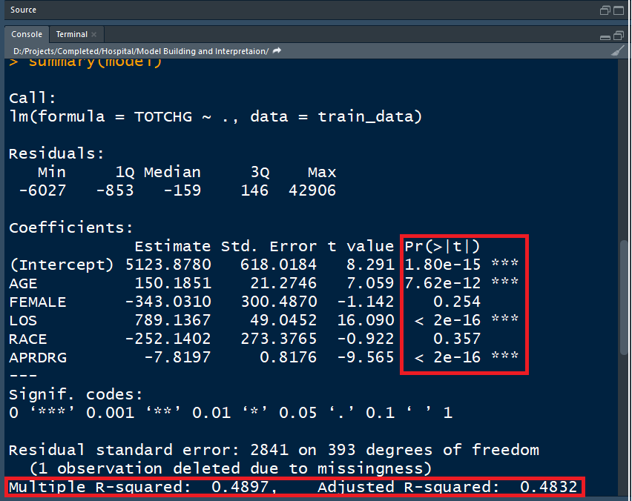
model interpretation
1. P value of Age, Female and APRDRG is less than 0.05, So they are Significant variable.
2. Slope of Significant independent Variables:-
Age: 150.18
LOS: 789.13
APRDRG: -7.819
3. (a). One unit increase in Age will Increase TOTCHG by 150.18
(b). One unit increase in LOS will increase TOTCHG by 789.13
(c).One unit increase in APRDRG will decrease TOTCHG by 7.819
4. R squared is 0.4897, So 48.97% of dependent variable is explained by independent variables.
5.Adjusted R squared is 0.4832 which is less than R Squared.
6.Rebuilding Model because more than 1 significant independent Variable.

Slide 4
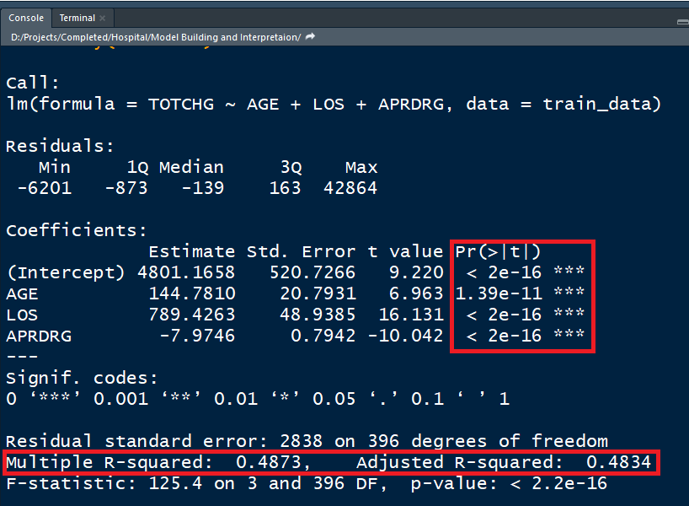
Rebuilding model
1. P value of Age, Female and APRDRG is less than 0.05, So they are Significant variable.
2. Slope of Significant independent Variables:-
Age: 144.78
LOS: 789.42
APRDRG: -7.97
3. (a). One unit increase in Age will Increase TOTCHG by 144.78
(b). One unit increase in LOS will increase TOTCHG by 789.42
(c).One unit increase in APRDRG will decrease TOTCHG by 7.97
4. R squared is 0.4873, So 48.73% of dependent variable is explained by independent variables.
5.Adjusted R squared is 0.4834 which is less than R Squared.

Slide 5
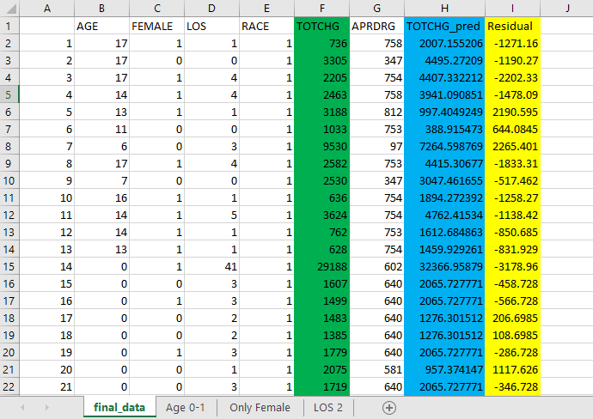
conclusion
We can see that Residuals are high so
this model is not good.

